Slide 1
Dimensionality reduction and autoencoders
Stephen Portillo
CfA Machine Learning Journal Club
19 October 2018

Slide 2



Autoencoders
Goal: learn a compression of data that allows reconstruction
data
reconstruction
$$x$$
$$x^{′}$$
code
encoder
decoder
$$z$$

Slide 3
Autoencoders + PCA
If encoder/decoder are linear, this is just PCA!
So autoencoders are a kind of non-linear PCA
data
reconstruction
$$x$$
$$x^{′}$$
code
encoder
decoder
$$z$$

Slide 4
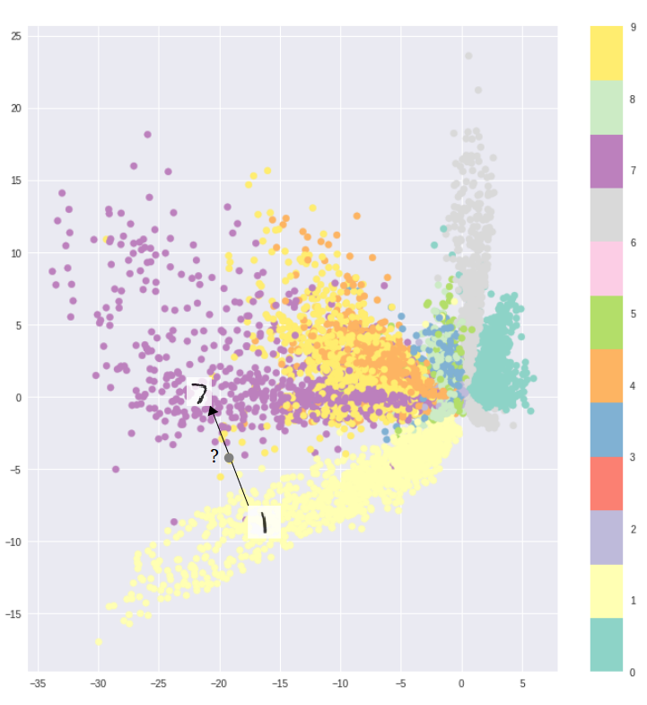

Autoencoder Issues
Good compression doesn’t mean that latent space $z$ is continuous
Irhum Shafkat, “Intuitively Understanding Variational Autoencoders”

Slide 5
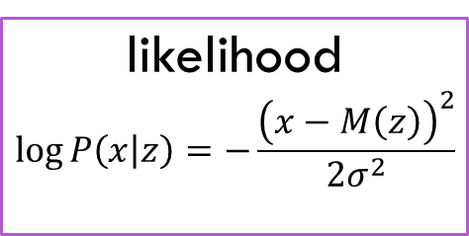

Autoencoders, Bayesian Style
Kingma & Welling, ICML 2014
arXiv:1312.6114
Decoder is a model for the data given the code
Loss function can be thought of as a likelihood
data
reconstruction
$$x$$
$$x^{′}$$
code
encoder
decoder
$$z$$
$$M\left(z\right)$$
likelihood
$$\log{P\left(x | z\right)}=−\frac{{\left(x−M\left(z\right)\right)}^{2}}{2σ^{2}}$$

Slide 6

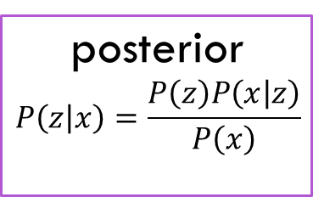



Autoencoders, Bayesian Style
Kingma & Welling, ICML 2014
arXiv:1312.6114
The likelihood (with a prior) implies a posterior
Use the encoder to approximate posterior as Gaussian
    This is variational inference!
data
reconstruction
$$x$$
$$x^{′}$$
code
encoder
decoder
$$z$$
$$μ_{z}$$
$$σ_{z}$$
$$q\left(z|x\right)$$
$$M\left(z\right)$$
posterior
$$P\left(z | x\right)=\frac{P\left(z\right)P\left(x | z\right)}{P\left(x\right)}$$
likelihood
$$\log{P\left(x | z\right)}=−\frac{{\left(x−M\left(z\right)\right)}^{2}}{{2σ}^{2}}$$

Slide 7
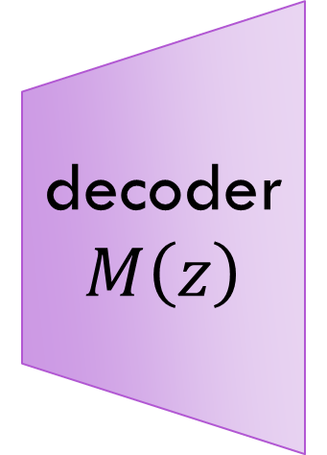


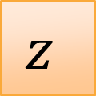



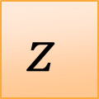


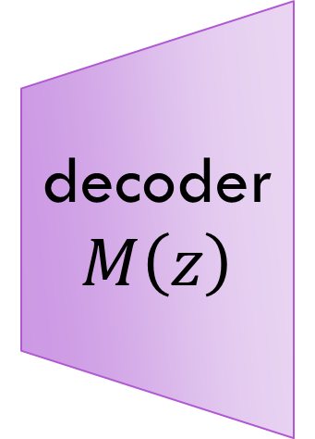

“Reparameterization Trick”
You can’t take gradients with $z\sim 𝒩\left(μ_{z},σ_{z}\right)$
But you can with
$z=μ_{z}+σ_{z}×ε$
decoder
$$M\left(z\right)$$
decoder
$$M\left(z\right)$$
$$μ_{z}$$
$$μ_{z}$$
$$z$$
$$z$$
$$σ_{z}$$
$$σ_{z}$$
$$ε$$
$$\sim 𝒩\left(0,1\right)$$

Slide 8

Variational Autoencoders
Kingma & Welling, ICML 2014
arXiv:1312.6114
Start with Bayes’ theorem
Recall that the KL divergence is
So add $\log{q\left(z | x\right)}$ to each side of Bayes and integrate over $q\left(z | x\right) dz$ to yield

Slide 9
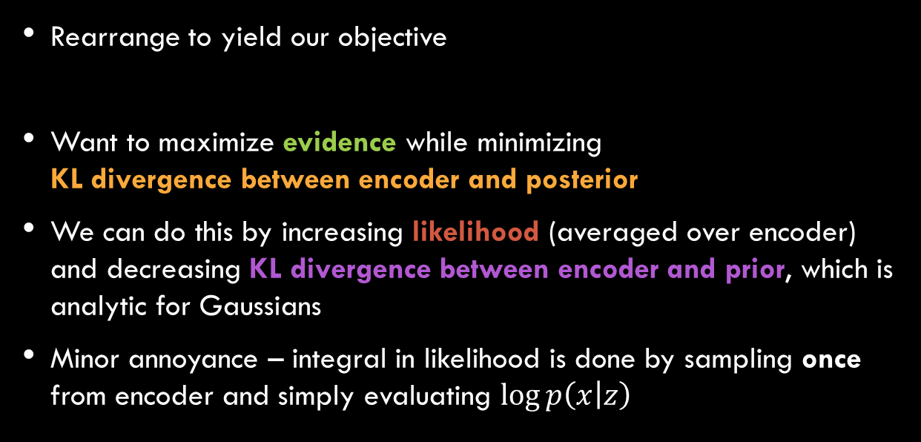
Variational Autoencoders
Kingma & Welling, ICML 2014
arXiv:1312.6114
Rearrange to yield our objective
Want to maximize evidence while minimizing
KL divergence between encoder and posterior
We can do this by increasing likelihood (averaged over encoder) and decreasing KL divergence between encoder and prior, which is analytic for Gaussians
Minor annoyance – integral in likelihood is done by sampling once from encoder and simply evaluating $\log{p\left(x | z\right)}$

Slide 10
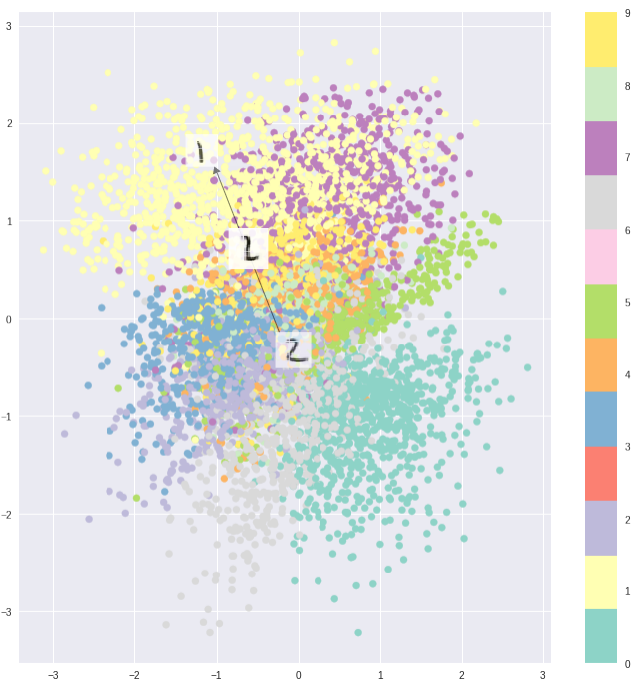
Variational Autoencoders
Penalizing KL divergence between encoder and prior encourages encodings to stay together
Irhum Shafkat, “Intuitively Understanding Variational Autoencoders”

Slide 11



Disentangled Variational Autoencoder ($β$-VAE)
Burgess et al., NIPS 2017
arXiv:1804.03599
Upweight the KL divergence contribution to the objective with $β>1$
Encourages the encoder to only differ from the prior when it really needs to – using fewer dimensions of latent space

Slide 12
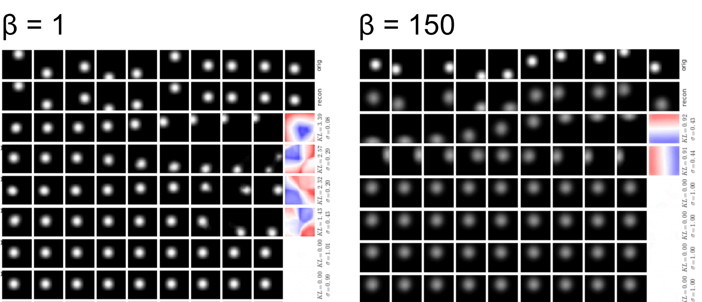
Disentangled Variational Autoencoder ($β$-VAE)
Burgess et al., NIPS 2017
arXiv:1804.03599

Slide 13
References
https://www.jeremyjordan.me/variational-autoencoders/ has a lot of links, of which I liked:
https://www.youtube.com/watch?v=9zKuYvjFFS8
https://towardsdatascience.com/what-a-disentangled-net-we-weave-representation-learning-in-vaes-pt-1-9e5dbc205bd1
http://ruishu.io/2018/03/14/vae/
https://blog.keras.io/building-autoencoders-in-keras.html
https://towardsdatascience.com/intuitively-understanding-variational-autoencoders-1bfe67eb5daf
https://arxiv.org/abs/1606.05908
https://arxiv.org/abs/1804.03599

